Slide 1







Semester
Project
Data Structure & Algortithm
MAZE EXPLORER
A GRAPH-BASED ADVENTURE GAME
|
Instructor:
Wasif Ali | Abrar Ahmed | Jawad Mustafa
Muhammad Kamran

Slide 2

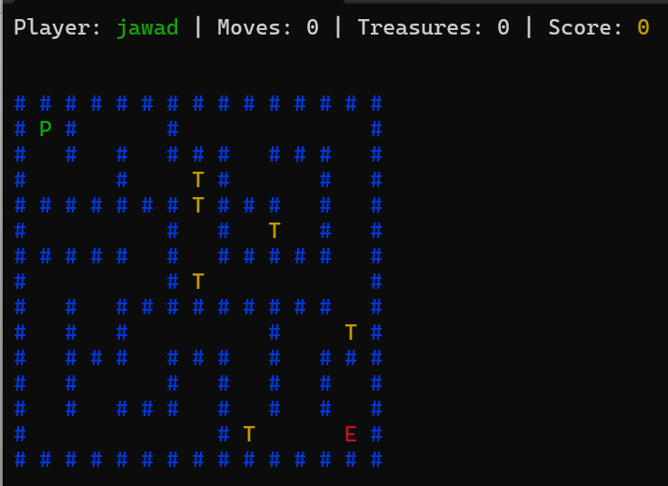
PROJECT OVERVIEW
“TURNING DATA STRUCTURES AND ALGORITHMS INTO AN INTERACTIVE, REAL-WORLD EXPERIENCE.”
|
Graph-Based Adventure Game
|
Core DSA Integration
|
|
DFS Maze Generation
BFS
Shortest Path

Slide 3

PROBLEM STATEMENT
Challenges in Traditional Learning
Lack of Visualization
Need an Interactive System
DSA is often taught in a theoretical manner.
Students struggle to connect concepts with real-world applications.
Algorithms run behind the scenes and are hard to visualize.
An interactive system helps demonstrate algorithm behavior clearly.
Maze problems are widely used in AI, robotics, and navigation systems.

Slide 4
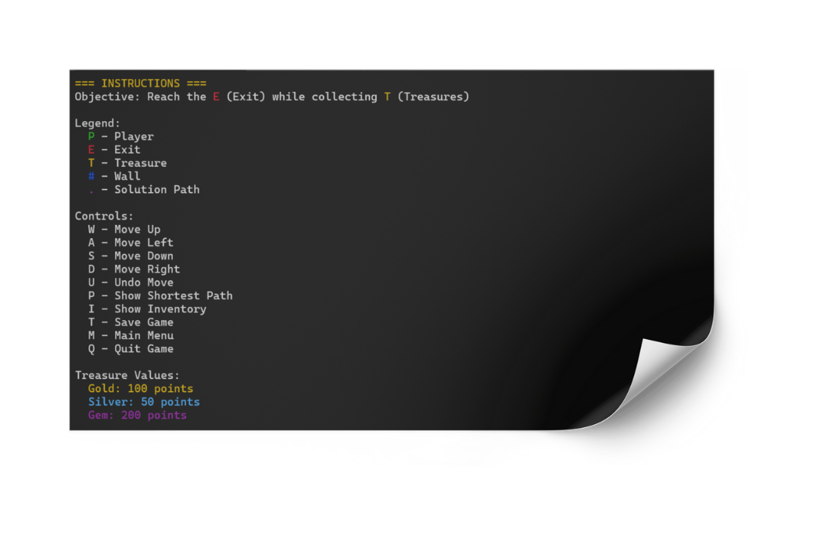

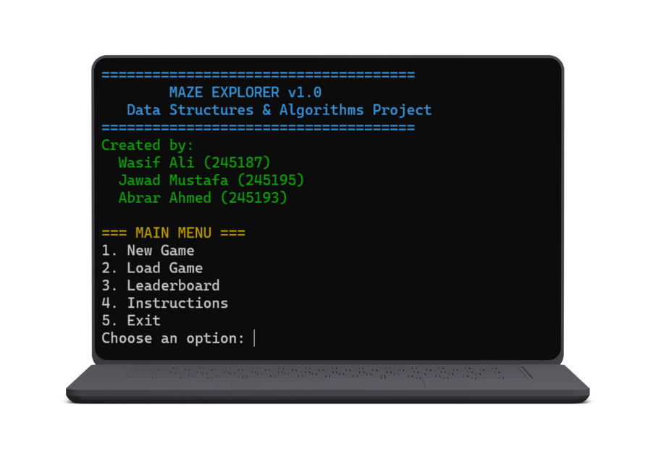
PURPOSE OF THE SYSTEM
  Practical DSA Application
  Graph-Based Maze Model
  BFS Shortest Path
  Stack-Based Undo
  AVL Leaderboard System
  File Handling Persistence

Slide 5
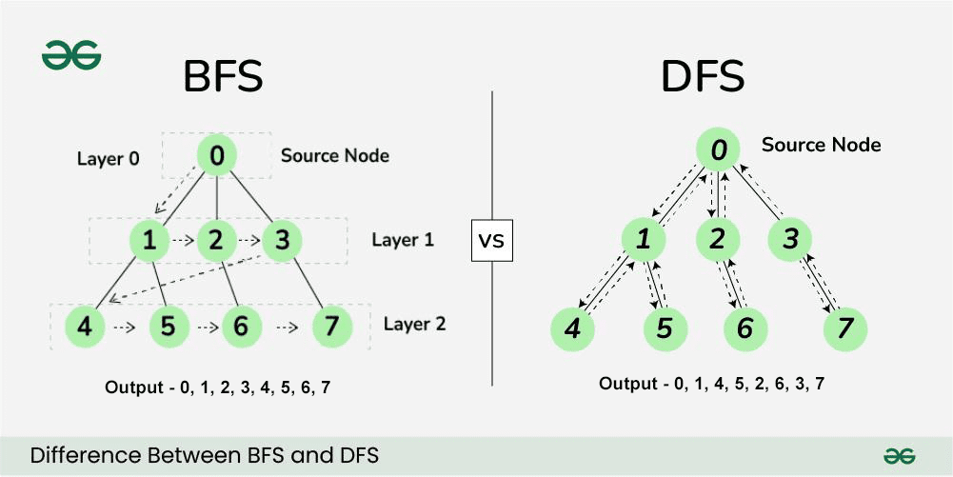

ALGORITHMS USED
DEPTH FIRST SEARCH (DFS):
BREADTH FIRST SEARCH (BFS):
DFS is used to generate the maze by exploring one path deeply before backtracking. It randomly carves paths and removes walls, ensuring that the maze is fully connected and always solvable.
BFS explores the maze level by level starting from the player’s position. It guarantees the shortest and optimal path to the exit by visiting all possible paths systematically.

Slide 6
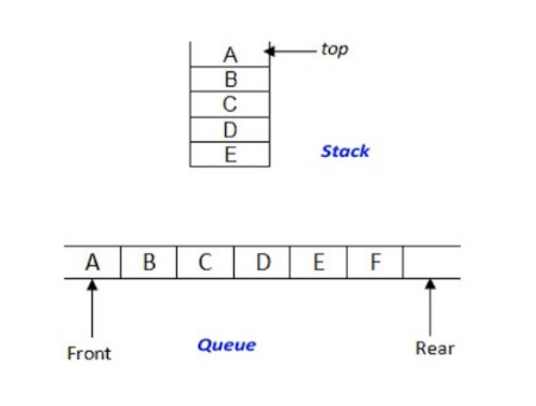
DATA STRUCTURES APPLIED
1
Graph (Adjacency List): Maze representation
2
Stack:
DFS & undo operations
3
Queue:
BFS traversal
4
AVL Tree:
Leaderboard ranking
5
Vectors & Maps:
Grid and state management

Slide 7
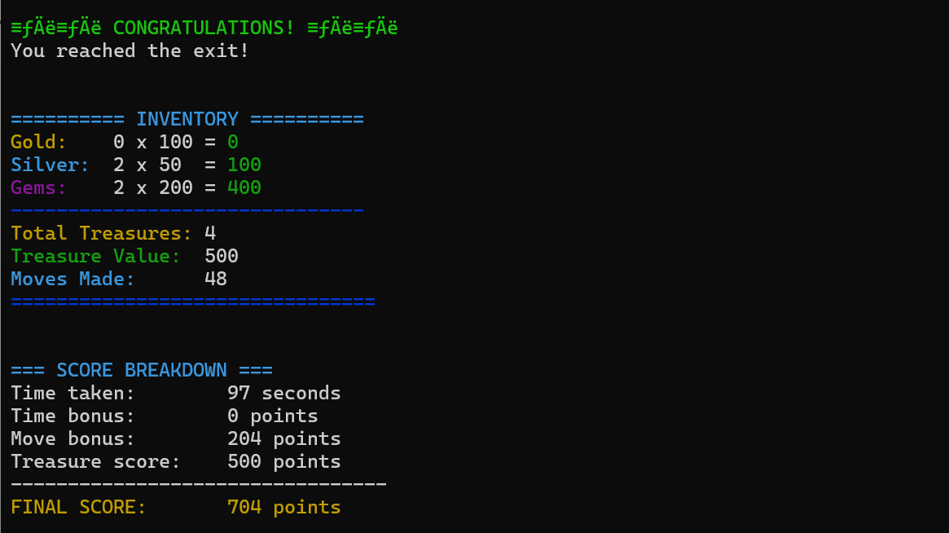
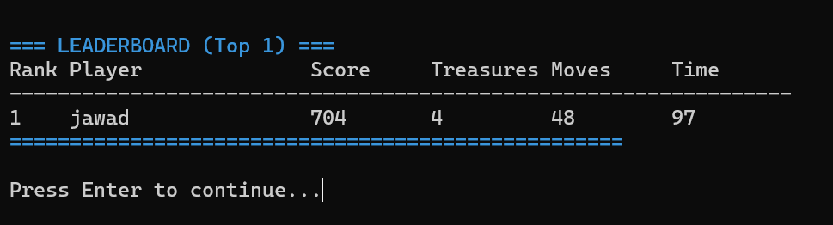
KEY FEATURES
  Random maze generation
  Shortest path hint system
  Undo player movement
  Treasure collection & scoring
  Persistent leaderboard

Slide 8



CHALLENGES
LIMITATIONS
  Mapping 2D grid to graph structure
  Ensuring maze solvability
  Path reconstruction in BFS
  Fixed maze size
  Terminal-based UI
  No diagonal movement

Slide 9

FUTURE ENHANCEMENTS
WHAT’S NEXT IN
MAZE GAME....
1
A* pathfinding algorithm
2
Dynamic maze size
3
Graphical UI (SFML/SDL)
4
AI-based player behavior

Slide 10


CONCLUSION
MAZE EXPLORER A GRAPH-BASED ADVENTURE GAME
The Maze Explorer effectively combines theory and practice by using DFS for maze generation and BFS for shortest path finding, while its modular C++ design ensures smooth game management, real-time rendering, and leaderboard handling, delivering a polished and engaging user experience.

Slide 11


THANK YOU
GRATEFUL FOR YOUR ATTENTION — QUESTIONS ARE WELCOME.

